Slide 1


Brain Health Challenge Progress report
Antonia
Weiping

Slide 2
Do sleep disturbances increase the risk of AD?

Slide 3
Pre-processing
Built own dataframe as previous group might have dropped observations we want to keep
Picked relevant tables and cleaned them up
Joined them on RID, VISCODE2 and Phase
Made new variables for insomnia, OSA (obstructive sleep apnea), depression from medical history (idea: if they have a history of insomnia or depression, were they more likely to develop or be diagnosed with AD at first diagnosis?)

Slide 4
Strategies
Sleep variables: NPIK(Neuropsychiatric Inventory – sleep disturbances), NPIK total score, NPIK severity, OSA(obstructive sleep apnea), insomnia
Direct: Sleep variables ---?--- Dementia diagnosis, Diagnosis change
Indirect:
Sleep variables ---?--- cerebrospinal fluid (CSF) biomarkers Amyloid beta (A-beta), tau, phosphorylated-tau (p-tau)
Sleep variables ---?--- brain volume
principal component analysis (PCA) of Sleep variables or combination of sleep variables depression (GD scale) and neuropsychological test (NEUROBAT)
Image Data analysis
compare clusters across CSF biomarkers and neuroimaging
individual NPI, GDscale, Neurobat and neuroimaging
Notes:
CSF biomarkers: useful in detecting the preclinical as well as symptomatic stages of AD
PCA of sleep or sleep+GDSCALE to see if there is a sleep predominant cluster or group (among clusters)

Slide 5
?
Diagnosis changes
Sleep variables:
- NPIK, OSA, Insomnia

Slide 6
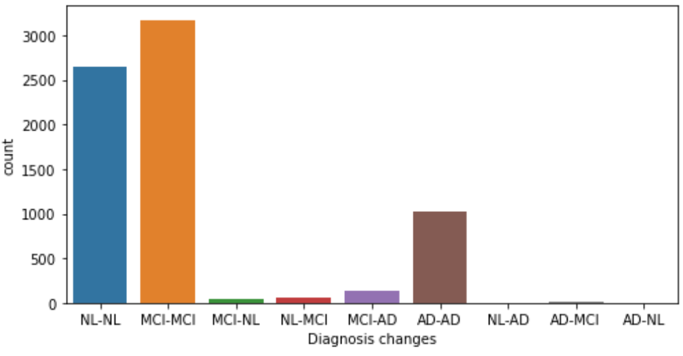
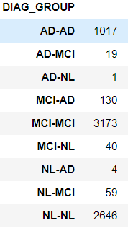
Sleep vs diagnosis changes
# 22201 observations
9A. Frequency Ratings. 1: Occasionally 2: Often 3: Frequently 4: Very frequently Insomnia: sleep disorder,have trouble falling and/or staying asleep

Slide 7
Sleep vs diagnosis changes
Part1: Will my status get worse or not?
- MCI --> AD or MCI --> MCI/NL
# 22201 observations

Slide 8
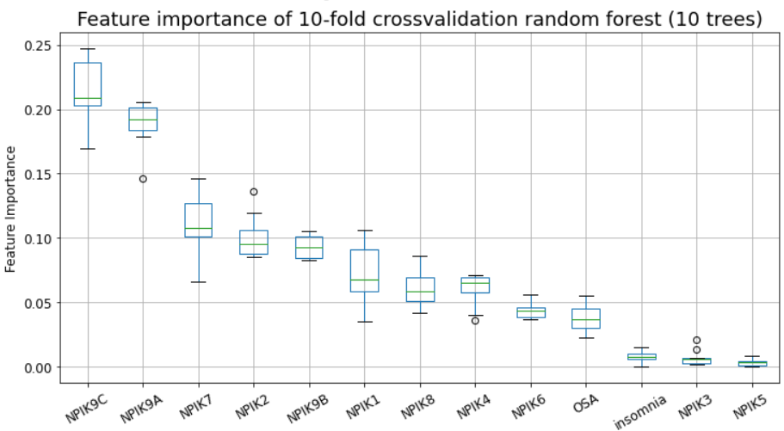
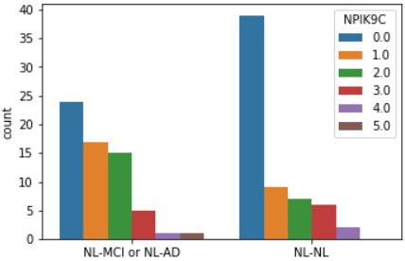
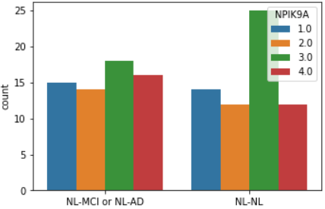
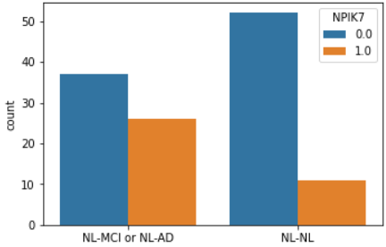
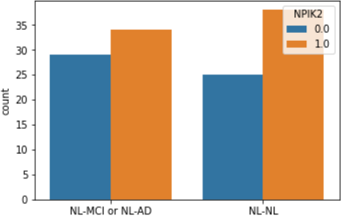
Sleep vs diagnosis changes
Part1: Will my status get worse or not?
- NL --> MCI/AD or NL --> NL
F1-score: 0.633
NL-MCI/AD: 63
NL-NL: 63

Slide 9
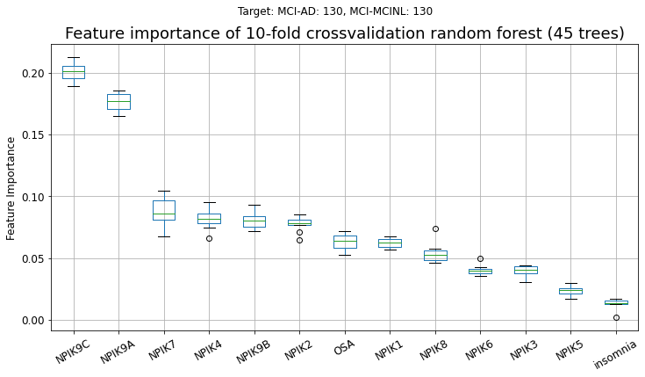
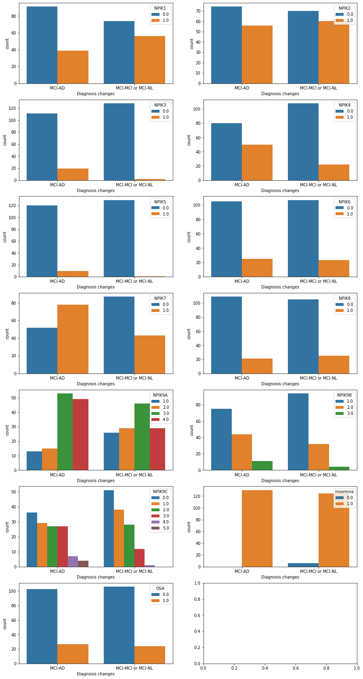
Sleep vs diagnosis changes
Part1: Will my status get worse or not?
- MCI --> AD or MCI --> MCI/NL
F1-score: 0.710
MCI-AD: 130
MCI-MCI/AD: 130

Slide 10
Sleep vs diagnosis changes
# 22201 observations
9A. Frequency Ratings. 1: Occasionally 2: Often 3: Frequently 4: Very frequently Insomnia: sleep disorder,have trouble falling and/or staying asleep

Slide 11
Sleep vs diagnosis changes
# 22201 observations
9A. Frequency Ratings. 1: Occasionally 2: Often 3: Frequently 4: Very frequently Insomnia: sleep disorder,have trouble falling and/or staying asleep

Slide 12
Sleep vs diagnosis changes
# 22201 observations
9A. Frequency Ratings. 1: Occasionally 2: Often 3: Frequently 4: Very frequently Insomnia: sleep disorder,have trouble falling and/or staying asleep

Slide 13
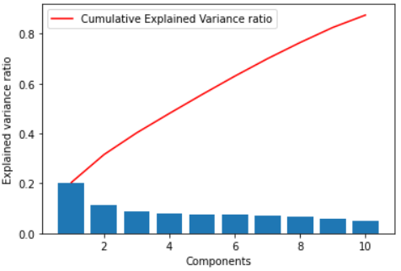
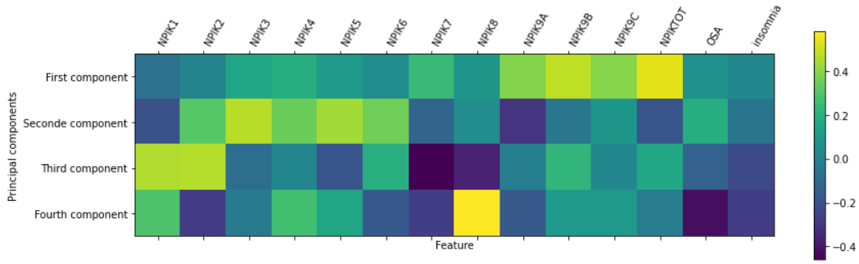
Principal components analysis
10 components are needed to explain 90% of the variances.
Not that much less than 14 (number of features).
Maybe not that helpful for reducing the dataset sizes.

Slide 14
Classification models
Target variable | method | F1-score (training, test) On scaled data | F1-score (training, test) On PCA data (4 PC)
Diagnosis change | Logistic regression K-nearest neighbours Decision tree Multi-layer perceptron | Both max. 0.5 - 0.568; 0.527 0.614; 0.471 | 0.667; 0.656 0.606; 0.354 0.605; 0.600 0.658; 0.431
Current diagnosis | Logistic regression K-nearest neighbours Decision tree Multi-layer perceptron | 0.592; 0.488 - 0.600; 0.547 0.868; 0.490 | 0.582; 0.570 0.581; 0.514 0.568; 0.51 0.705; 0.453
Baseline Diagnosis | Logistic regression K-nearest neighbours Decision tree Multi-layer perceptron | 0.634; 0.623 - 0.762; 0.758 0.768; 0.614 | 0.782; 0.777 0.690; 0.568 0.782; 0.777 0.774; 0.584

Slide 15
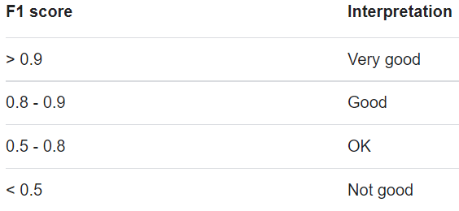

Slide 16
Sleep variables:
NPIKSEV
OSA
Insomnia
CSF biomarkers:
A-beta
Tau
PTau
?

Slide 17
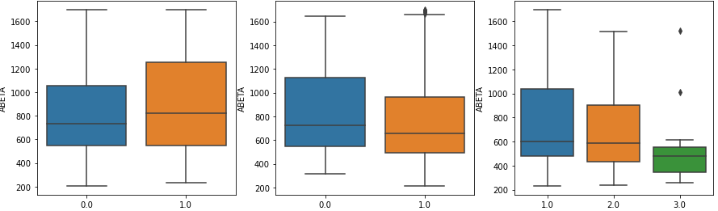
Abeta
OSA INSOMNIA NPIKSEV
NPIKSEV:
1 - Mild (noticeable, but not a significant change)
2 - Moderate (significant, but not a dramatic change)
3 - Severe (very marked or prominent. A dramatic change).

Slide 18
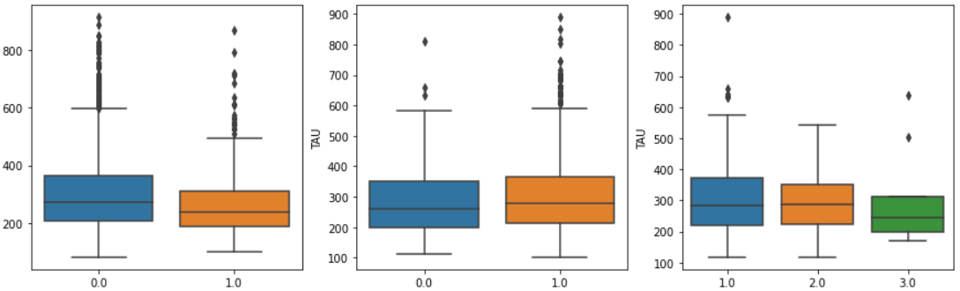
Tau
OSA INSOMNIA NPIKSEV
NPIKSEV:
1 - Mild (noticeable, but not a significant change)
2 - Moderate (significant, but not a dramatic change)
3 - Severe (very marked or prominent. A dramatic change).

Slide 19
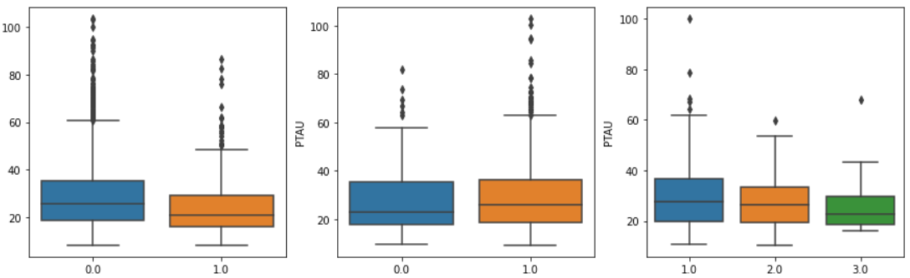
PTau
OSA INSOMNIA NPIKSEV
NPIKSEV:
1 - Mild (noticeable, but not a significant change)
2 - Moderate (significant, but not a dramatic change)
3 - Severe (very marked or prominent. A dramatic change).

Slide 20
AD Diagnosis
?
GDSCALE
NPIK

Slide 21
Preliminary results – NPI vs Diagnosis
Weiping
Charts -> Biomarkers (ABETA / PTAU / TAU) vs.
-> Trying to predict
Objective actigraphy
Polysomnography
actigraphy
Homer1a, best-known molecular marker of sleep need (Maret et al. 2007; Archer and Oster 2015; Diering et al. 2017)
Obstructive sleep apnea (OSA), or called sleep disordered breathing (SDB)

Slide 22
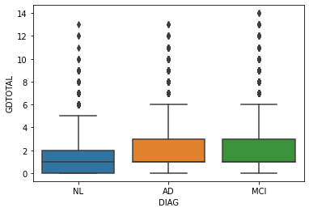
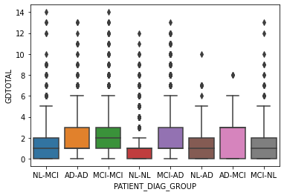
Preliminary results – GDscale vs. Diagnosis
Only small differences between the diagnosed groups
Usually low scores (mostly below treshhold for depression)
Maybe analyzing individual questions gives better results

Slide 23
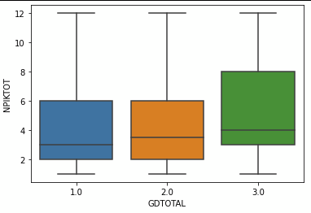
Preliminary results – GDScale vs NPI
People in GD category 3 (depressed) have a slightly higher NPIK score
GD categories:
<5 Points: depression not likely (1)
>5 Points: suggests depression and should be followed by a comprehensive assessment (2)
≥10 Points: almost always indicates depression (3)

Slide 24
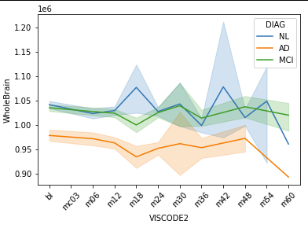
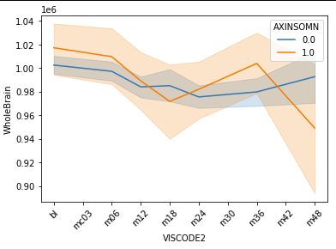
Preliminary results – Brain volume
Development of brain volume over time (measured by visit code)
Alzheimer group has lowest volume
Insomnia seems to indicate lower brain volume, but data has high variance

Slide 25
Next Steps
Train ML algorithms trying to predict a change in diagnosis based on NPI scores / history of insomnia
See if adding in depression data changes the model
Analyse brain volume vs. NPI scores
Image analysis (unsupervised clustering)

Slide 26
Questions
Abeta, tau, P-tau in ADNImerge and UPENN...?
Not sure how to interpret NPIK score and how to define cut offs (is NPIKTOT already including frequency and severity or not? Could not find formula online)
Understanding the science part – what is really relevant, what is coincidence etc?
Brain volume: known link to sleep problems and brain volume?

